Slide 1
Presentation on TIC-TAC-TAE Game
-By Ch. Siri Chandana

Slide 2
Agenda
Introduction
Working
Uses
Advantages and Disadvantages
Future scope

Slide 3
Introduction
Tic tac toe Python, also known as Noughts and Crosses or Xs and Os, is a very simple two-player game where both the player get to choose any of the symbols between X and O.
This game is played on a 3X3 grid board and one by one each player gets a chance to mark its respective symbol on the empty spaces of the grid.
Once a player is successful in marking a strike of the same symbol either in the horizontal, vertical or diagonal way as shown in the picture below is created that player wins the game else the game goes on a draw if all the spots are filled.

Slide 4
Working
Calls create_board() to create a 3×3 board and initializes with 0.
For each player (1 or 2), calls the random_place() function to randomly choose a location on board and mark that location with the player number, alternatively.
Print the board after each move.
Evaluate the board after each move to check whether a row or column or diagonal has the same player number. If so, displays the winner’s name. If after 9 moves, there is no winner then displays -1.

Slide 5
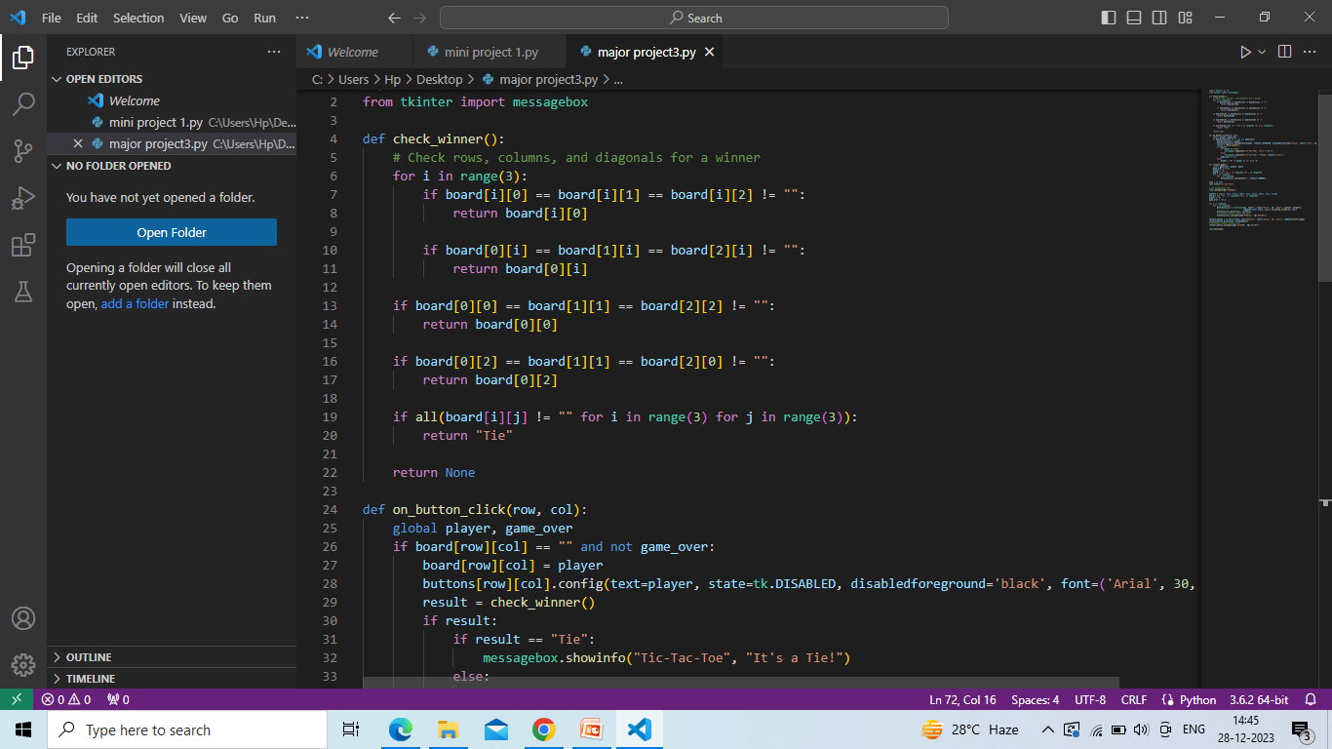
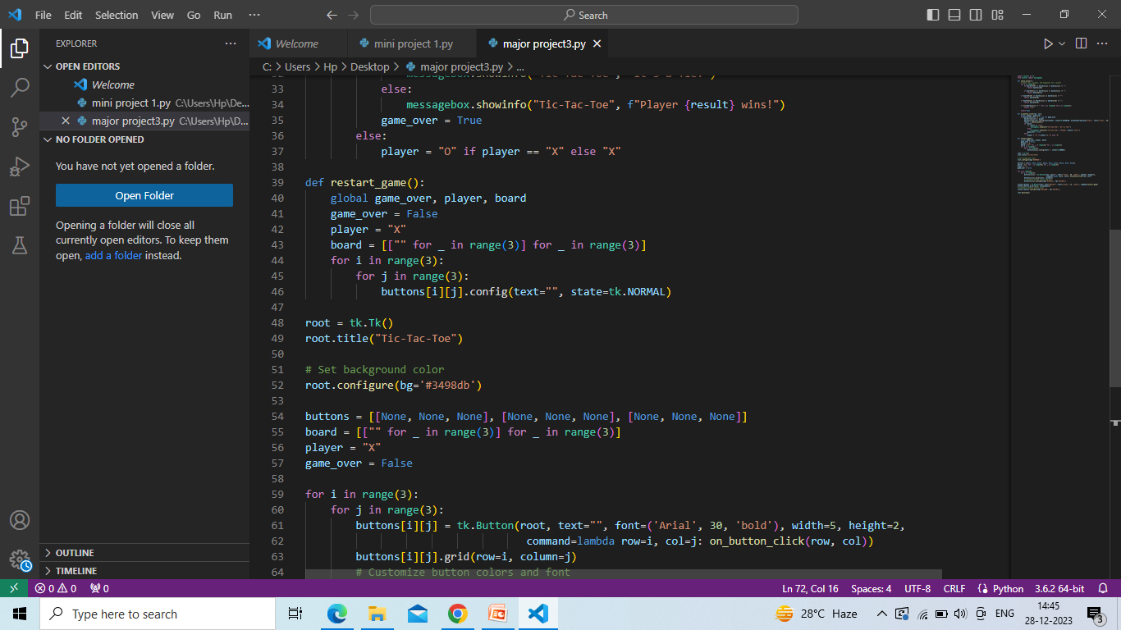

Slide 6
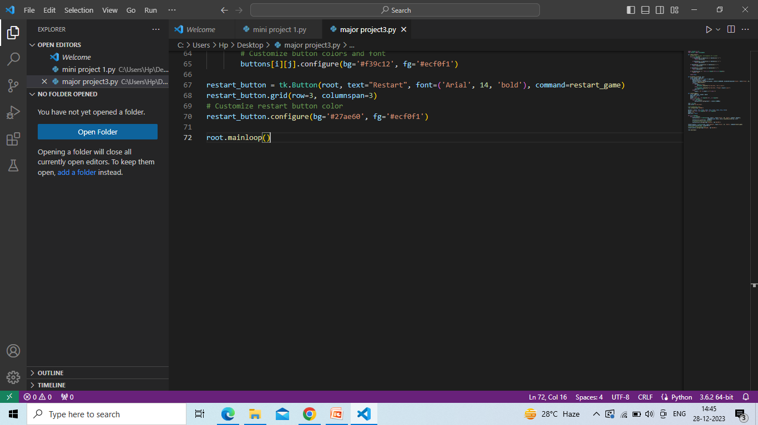

Slide 7
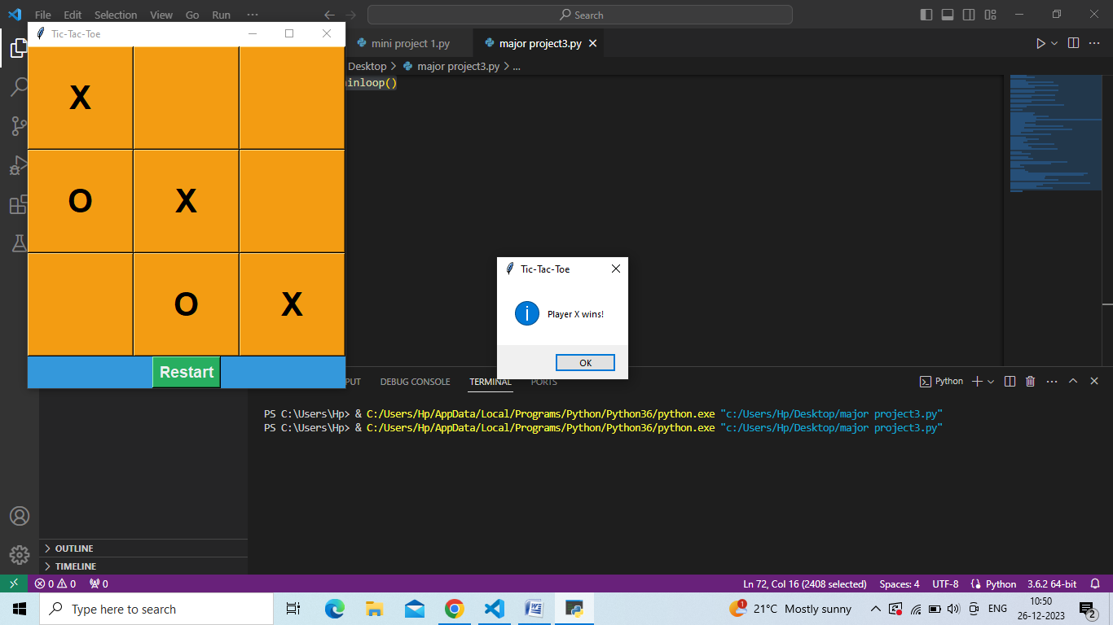
Result

Slide 8
Uses
Tic Tac Toe can be used to promote a number of cognitive skills including counting and spatial skills, and color and shape identification.
Hence, tic-tac-toe is often played by young children who may not have discovered the optimal strategy. Because of the simplicity of tic-tac-toe, it is often used as a pedagogical tool for teaching the concepts of good sportsmanship and the branch of artificial intelligence that deals with the searching of game trees.

Slide 9
Advantages:
Easy to learn.
Quick Complexity.
Portable and pen-and-paper Friendly.
Disadvantages:
Possibility of Draws.
Limited complexity and depth.

Slide 10
Future scope
Tic Tac Toe continues to evolve with advantagement in technology .In the future, we can expect to see AI algorithms that learn and adapt from playing million of games, making the game more challenging and exciting. Additionally ,virtual reality and Augumented reality could offer new immersive experiences for players.

Slide 11
Thank you ☺

